Slide 1




Army National Guard (ARNG) and United States Army Reserve (USAR)
Non-Regular Retirement Planning Seminar
HQ, Army Retirement Services 251 18th Street S., Suite 210
Arlington, VA 22202-3531
22 March 2023

Slide 2






Purpose
To provide an overview of the non-regular retirement process in order to make an informed military retirement decision.
15-20+ creditable years
Pre-non-regular retirement age
Reserve Component Survivor Benefit Plan (RCSBP) Coverage Option A, B or C
Maintain RCSBP
Non-regular retirement
Survivor Benefit Plan (SBP) Coverage
Manage Retirement Points
Maintain SBP
Step 1
Step
Step
2
3
Receive non-regular retired pay
Complete application for non-regular retired pay (if eligible apply for reduced age retirement)
Maintain updated contact information with HRC Complete application for transfer into the Retired Reserve
RCSBP election (within 90 days of receiving the NOE) Receipt of NOE
Anniversary Year Ending (AYE) – Notification of Eligibility (NOE) is generated and sent to the Soldier 90-120 days after AYE.
Notes:
Presenter Notes
2023-03-22 21:16:05
--------------------------------------------
Step 1 – Manage your retirement points Step 2 – Attend a retirement briefing Step 3 – How to apply for retirement pay

Slide 3
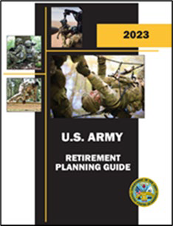

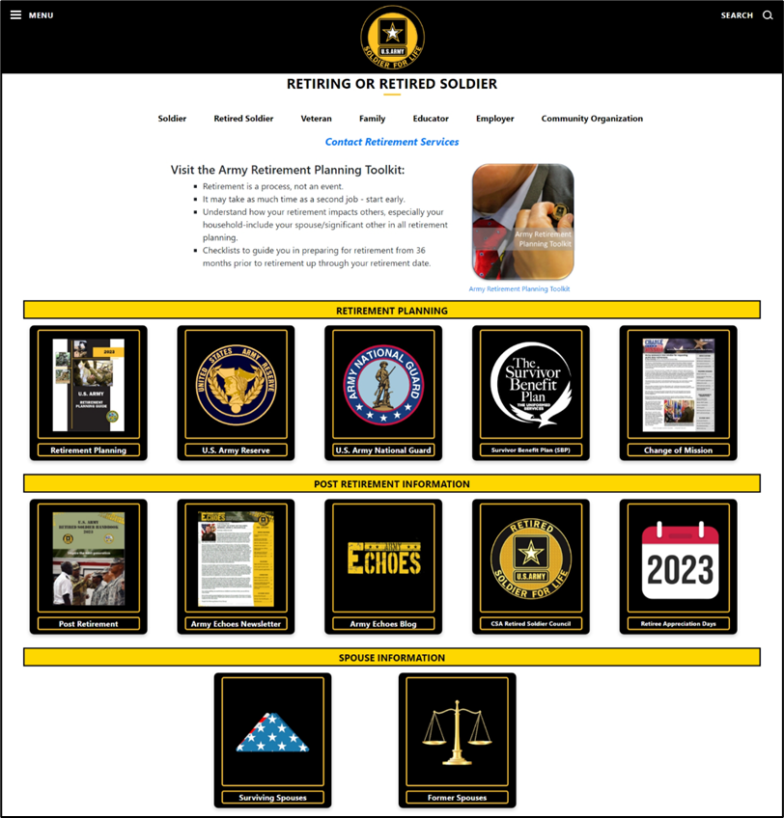

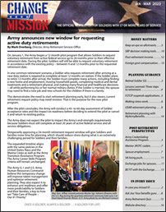




The Army Retirement Services Website
https://soldierforlife.army.mil/Retirement
Former Spouses

Slide 4
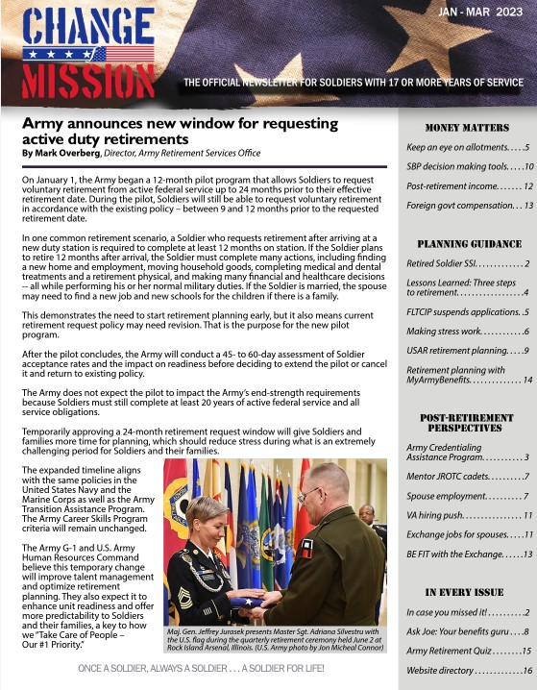
Change of Mission
U.S. Army’s official retirement planning newsletter for Soldiers in all three components with 17+ years of service
Published via myPay SmartDoc in Jan, Apr, Jul and Oct
Sent to 186K Soldiers quarterly. If you didn’t receive it, check your email address in myPay
Available at https://soldierforlife.army.mil/retirement/change-of-mission

Slide 5
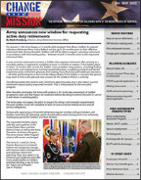
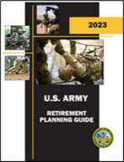







Non-Regular Retirement Process
18-20 years of service
Attend Mandatory Retirement Planning Seminar
Receive your RCSBP Briefing
15-17 years of service
- Ensure your retirement points are correct
17+ years of service
- Gather Resources
9 months prior to Transferring to the Retired Reserve
Apply for transfer to Retired Reserve or Discharge
Reduced Age Eligibility
Final PHA
After 20-year NOE
Check Service obligation
Determine desired retirement date
Plan for medical/dental if applicable
20 years of service
Receive RCSBP Briefing if you haven’t already
Complete the DD Form 2656-5 (within 90 days of receipt of NOE)
30 days prior to transferring to the Retired Reserve
(if not already done)
Retirement ceremony
DS Logon
myPay
Update contact info in MyRecordPortal
0-3 months after transferring to the Retired Reserve
New ID cards
- TSP
Apply for TRICARE if applicable
Gray Area
- Maintain correct POC information
- TRICARE Enrollment (if not already done)
9 months prior to 60th birthday or Early Age Drop
- Apply for retired pay
Placed on Retired List
- New ID Card
- Apply for TRICARE
For detailed information regarding this timeline, refer to the U.S. Army Retirement Planning Guide located at https://soldierforlife.army.mil/Retirement/retirement-planning
Notes:
Presenter Notes
2023-03-22 21:16:06
--------------------------------------------
This is an overview of what a Non-Regular Retirement planning timeline looks like. We developed this timeline to assist when planning for retirement, at your 15-17yrs of service, you should review your retirement points for accuracy and or corrections. Between your 18-20yrs of service, you should be attending a mandatory Retirement Planning Seminar.
It is our job as an RSO to help Soldiers and their Families plan for retirement by giving them the information they need. One way to provide information is to conduct pre-retirement activities, such as briefings and communications for groups. All Retiring Soldiers should attend pre-retirement briefings between their 18-20yrs of service or at least 12 months before their transition. The Retirement Services Office recommends Spouses attend the briefings as well.
When you attend a Retirement Planning Seminar, you will learn about:
Service member’s Group Life Insurance -- a program to provide low-cost group life insurance to Service Members.
Veteran’s Group Life Insurance -- a program that allows Veterans to convert full-time SGLI coverage to lifetime renewable term insurance.
Combat-related special compensation --Special non-taxable compensation for combat-related disabilities to recover some or all of the retired pay that military Retirees waive for VA disability compensation.
Concurrent retirement and disability pay--Restoration of retired pay for Retirees with service-connected disabilities. It is considered taxable income and is taxed in the same manner as retired pay. Eligible retirees receive CRDP automatically.
RC Survivor Benefit Plan--A program through which the Department of Defense provides monthly, cost-of-living-adjusted income to eligible Survivors of Soldiers who die on Active Duty, including Reserve Soldiers and National Guard Soldiers who die on Federal Active Duty, and of Retirees who choose to continue participating in the program after they retire. TRICARE--Health care program for Active Duty Service members, National Guard and Reserve members, Retirees, their Families, Survivors, and certain Former Spouses.
IAW AR 600-8-7, paragraph 7-4, Soldiers wishing to be discharged instead of transferred to the Retired Reserve must be counselled in writing by the first lieutenant colonel in the chain of command to explain the impact on their retired pay and benefits. A Soldier who is eligible to receive retired pay, at age 60, for non-regular service pursuant to chapter 1223 of Title 10, United States Code, but who has been discharged and who maintains no military affiliation is considered a former member. The TRICARE page states that Soldiers must be: “Retired Reserve members who are: Members of the retired Reserve of a Reserve Component who are qualified for non-regular retirement under 10 U.S.C., Chapter 1223 and Under age 60.” (discharged Soldiers/former members are ineligible for TRICARE Retired Reserve) NOTE: At age 60, retired Soldiers and their eligible dependents are entitled to medical care, commissary, exchange, and morale, welfare, and recreation (MWR) privileges. Former members under age 60, and their eligible dependents are entitled to commissary, exchange, and MWR privileges only.
Does anyone have any questions?

Slide 6
Non-Regular (Reserve) Retirement
Retirement eligibility
  20 years of creditable service for a length of service retirement
  15 years of creditable service for a medical retirement
  If you completed 20 years of service before 25 April 2005, you will have a reserve component service requirement
Retirement Points = Retired Pay: verify yours are correct now!
The MyArmyBenefits retirement calculator automatically pulls retirement points from IPPS-A! https://myarmybenefits.us.army.mil/Benefit-Calculators/Retirement
Notes:
Presenter Notes
2023-03-22 21:16:06
--------------------------------------------
Since 25 Apr 05 there is no longer a requirement for serving a mandatory number of years in the RC before being eligible to retire. Prior to that, the 6 or 8 year rule may apply (See Title 10 USC §12731 for additional info) NOE=Notification of Eligibility (NOE) for non-regular retired pay at age 60, commonly referred to as the 15 year letter (medical retirement with 15 or more years of creditable service but less than 20) or 20 year letter Retirement eligibility age may be reduced based off of qualifying periods of active duty service:
-On or after 29 Jan 08, each day on that AD tour counts toward a reduction in retirement age for Reserve Component Service Members. AD orders that qualify for the reduction in retirement age fall under section 101(a) (13)(B), and performed under section 688, 12301 (a), 12302, 12304, 12305, 12406, or chapter 15 (insurrection), or under section 12301 (d) of Title 10 USC.
-Title 32 section 502(f) is also qualifying service for reduced age eligibility: "Full-time National Guard duty under Section 502(f) for the purpose of responding to either a national emergency declared by the President, or a national emergency supported by Federal funds is qualifying service for reduced age

Slide 7
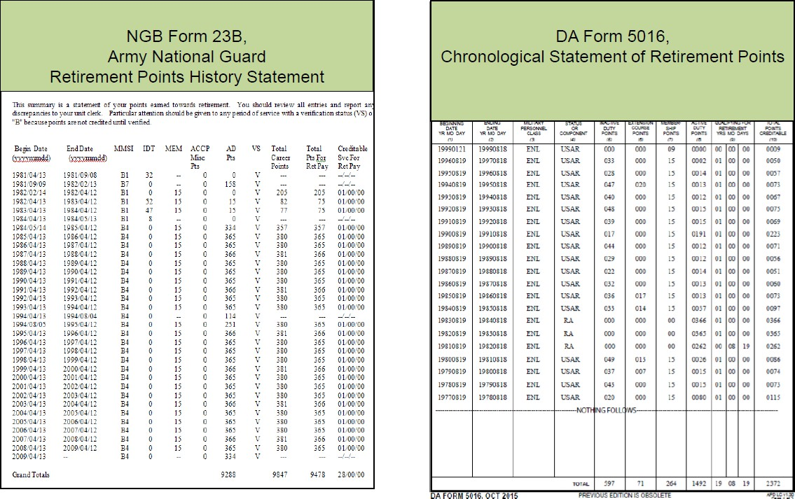
Manage Retirement Points
ARNG USAR

Slide 8
15- or 20-Year Notification of Eligibility (NOE)
Under T10 USC section 12731, RC Soldiers who complete 20 years of qualifying service will be issued the Notification of Eligibility (NOE) for Retired Pay at Age 60 (commonly referred to as the 20-year letter) within 1 year after completion of required service
RC Soldiers who complete at least 15, but less than 20 years of qualifying service who are deemed unfit for continued Selected Reserve service will be issued a 15-year NOE
NOEs will be mailed to eligible Soldiers to their address of record within 90-120 days of recording 20 years of qualifying service, and posted in their iPerms record
A 20-year NOE is not required for Soldiers who continue to serve in a drilling status and don't transfer to the retired reserve until after they reach age 59. (the applicable component may still issue the NOE; however, it is not a required document for submission of the non- regular retirement application packet)
Notes:
Presenter Notes
2023-03-22 21:16:06
--------------------------------------------
Requirement to Issue the NOE is under T10 USC section 12731, and in AR 140-185 and NGR 680-2
Issued by HRC for all USAR Soldiers except those within 2 years of qualifying for an AFS retirement and can remain on active duty to complete the required service The State AG for all ARNG Soldiers serving in an active status in the State where assigned when they became eligible
90-120 days is if TAPDBR is correct
The intent of waiving the requirement to submit a copy the 20-Year NOE for Soldiers serving past age 59 is to allow for the retirement packet to be submitted immediately upon transfer to the Retired Reserve. Submission of an NGB Form 23 or DA Form 5016 showing 20 years of service is still required. MEB must come from the unit to request 15yr NOE from HRC

Slide 9
15- or 20-Year NOE (Cont’d)
USAR Soldiers can send NOE requests to usarmy.knox.hrc.mbx.tagd- 15-20-year-noe-request@army.mil, and can access their DA Form 5016 (Chronological Statement of Retirement Points) by logging into the My Record Portal at https://www.hrcapps.army.mil/portal/
ARNG Soldiers should contact their applicable state Retirement Points Accounting Management (RPAM) administrator for a copy of their NGB Form 23 (Retirement Points History Statement), and to ask questions about the NOE. A directory is available at https://www.milsuite.mil/book/docs/DOC-396107
Notes:
Presenter Notes
2023-03-22 21:16:06
--------------------------------------------
Requirement to Issue the NOE is under T10 USC section 12731, and in AR 140-185 and NGR 680-2
Issued by HRC for all USAR Soldiers except those within 2 years of qualifying for an AFS retirement and can remain on active duty to complete the required service The State AG for all ARNG Soldiers serving in an active status in the State where assigned when they became eligible
90-120 days is if TAPDBR is correct
The intent of waiving the requirement to submit a copy the 20-Year NOE for Soldiers serving past age 59 is to allow for the retirement packet to be submitted immediately upon transfer to the Retired Reserve. Submission of an NGB Form 23 or DA Form 5016 showing 20 years of service is still required. MEB must come from the unit to request 15yr NOE from HRC

Slide 10

Reserve Component Survivor
Benefit Plan (RCSBP)
A LAW enacted by Congress in 1978 for coverage between receipt of your Notification of Eligibility (NOE) for retired pay and when you start to receive retired pay.
What you did or did not do at the time of receipt of your 15- or 20-year NOE will impact your SBP election.
Prior to 1 January 2001, Soldiers who failed to make an election for RCSBP within 90 days of receipt their NOE were automatically prevented from enrolling until age 60.
From 1 January 2001 to present, Soldiers who fail to make an RCSBP election within 90 days of receipt of their NOE are automatically enrolled in RCSBP under option C (immediate coverage) for spouse
and/or child that the Soldier had upon receipt of the NOE.
RCSBP information is mailed to Soldier with the 20-year NOE and is also available online at https://soldierforlife.army.mil/Retirement/survivor-benefit-plan.
Notes:
Presenter Notes
2023-03-22 21:16:06
--------------------------------------------
o What is RCSBP? It is the sole means for an RC Soldier with 20yrs of qualifying service for non-regular retirement to provide a portion of their retired pay to survivors if they die before non-regular retirement. o RCSBP elections must be made within 90 days of receipt of Notification of Eligibility for Retired Pay (20yr NOE).
- Certain elections need spouse concurrence
- Certain elections affect your SBP elections
- Certain elections require payment of RCSBP premiums

Slide 11
Reserve Component Survivor
Benefit Plan (RCSBP)
See separate SBP/RCSBP mandatory briefings for more information and resources. Both can be found at:
https://soldierforlife.army.mil/Retirement/survivor-benefit-plan

Slide 12
Attend a Retirement Planning Seminar
1 Day Retirement Planning Seminars IAW AR 600-8-7 (Retirement Services Program)
Who: Soldiers with 18th or 19th years of service towards non-regular retirement, Gray Area Retired Soldiers, Soldiers in receipt of a 15-year NOE, and their families
What: Retirement Points, RCSBP/SBP, Retired Pay Application, VA, TRICARE, Federal Employees Dental and Vision Insurance Program (FEDVIP), ID/DEERS, MyArmyBenefits (other community partners i.e. SSA)
Where: Conducted in the largest target population cities (USAR), at the JFHQs (ARNG), or Virtually via Microsoft Teams or APAN
When: Saturdays with a minimum of 12 seminars per RD per year (USAR) Contact applicable State RSO for seminar dates (ARNG)
Why: To provide accessible information to Soldiers, Family members, and Gray Area Retired Soldiers. To provide education and counseling to make informed decisions related to retirement.
Key websites:
Soldier For Life, Preparing to Retire: https://soldierforlife.army.mil/retirement/preparing-to-retire USAR Retirements: https://www.usar.army.mil/Retirement/
ARNG Retirements: https://www.milsuite.mil/book/groups/arng-hrp-t-retirement-services/pages/retirement-services
Notes:
Presenter Notes
2023-03-22 21:16:07
--------------------------------------------
Retirement Planning Seminars:
- For USAR, you need to register for a retirement seminar with the Readiness Division your organization falls under.

Slide 13
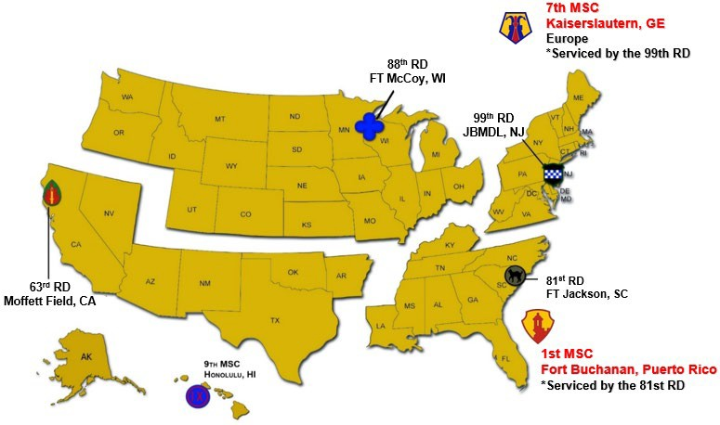





USAR Retirement Services Office Locations Areas of Responsibility
The 7th MSC is serviced by the 99th RD and 1st MSC is serviced by the 81st RD
Notes:
Presenter Notes
2023-03-22 21:16:07
--------------------------------------------
This is how we are geographically dispersed. We have 4 Readiness Divisions and the 9th MSC that has RSO teams to support the field. The Army Reserve footprint is large, and we only have 10 full time personnel to support our population.

Slide 14
ARNG Retirement Services Officers
ARNG Retirement Services Officers (RSOs) are located in every State, Territory, and in the District of Columbia. There is an RSO directory for all components available at https://soldierforlife.army.mil/Retirement/rso
ARNG Retirement Points Accounting Management (RPAM) Administrators are located in every State, Territory, and the District of Columbia
Contact information for ARNG RSOs and RPAM Administrators can be found at https://www.milsuite.mil/book/docs/DOC- 396107

Slide 15
Calculate Your Retired Pay in 3 Steps
Step 1: Determine your Date of Initial Entry into Military Service (DIEMS). **This is the date of your initial service contract. This date does not change regardless of breaks in service or changes in duty status.
Step 2: Determine which pay plan you are eligible for based on your DIEMS date
Step 3: Use the appropriate formula to calculate your retired pay (see following slides)
For a fast, personalized retired pay calculation, go to https://myarmybenefits.us.army.mil/Benefit-Calculators/ and click on the retirement calculator
Notes:
Presenter Notes
2023-03-22 21:16:07
--------------------------------------------
There are four retired pay plans.
To determine which plan you fall under and how your retired pay will be calculated, complete the following three steps. (Additional detail on each step is provided in subsequent slides.)
Step #1. Determine your date of initial entry into Military service, or DIEMS. Unless you know the definition of DIEMS, you won’t know what yours is, and you won’t be able to determine which retired pay plan you are eligible for. DIEMS is explained on the next slide. Step #2. Determine which pay plan you are eligible for based on your DIEMS. The three pay plans are discussed on the following slides.
Step #3. Use the formula of the appropriate pay plan to calculate your retired pay or just use the retired pay calculator at https://myarmybenefits.us.army.mil/Benefit-Calculators/Retirement. This calculator pulls all your personal data from DEERS to calculate your retired pay on the date you choose.

Slide 16
Retired Pay Plans
Retirement Plan | DIEMS
Final Basic Pay Plan (Years of creditable service (points/360) x 2.5%) x final basic pay | Prior to 8 September 1980
High-36 Pay Plan (Years of creditable service (points/360) x 2.5%) x average of highest 36 months of basic pay | Between 8 September 1980 and 31 July 1986
High-36 Pay Plan (calculation above) ~OR~ Career Status Bonus* (CSB)/REDUX Pay Plan (CSB was offered when eligible Soldiers reached 15 years of Active Federal Service (AFS), with an agreement to complete 20 years of AFS. Soldiers who declined CSB, remained under High-36 Pay Plan) REDUX: (Years of creditable service x 2.5%) minus 1% for each year < 30 years x average of highest 36 months of basic pay (applies to regular retirements under CSB/REDUX) *CSB no longer available as of 31 December 2017 | Between 1 August 1986 and 31 December 2017
Blended Retirement System (BRS) (Years of creditable service (points/360) x 2.0%) x average of highest 36 months of basic pay | 1 January 2018 or later, or opted-in during the opt-in period
Notes:
Presenter Notes
2023-03-22 21:16:07
--------------------------------------------
Credit for all full months served
Final Basic Pay Plan, High-36 Pay Plan and BRS receive Full COLAs
REDUX receives COLA minus 1%; one-time catch-up COLA at age 62; then COLA minus 1% after age 62
Final Basic Retired Pay Plan: Soldiers with a DIEMS prior to 8 Sep 80 will be retired under the Final Basic Pay Plan (T10 USC 1406) receive retired pay equal to 2.5% (called the “percentage multiplier”) of their final basic pay for each full year of creditable service, and 1 1/12th of 2.5% for each full month. Because these Soldiers receive a percentage of their FINAL month’s basic pay, they should avoid retiring just before reaching a basic pay milestone such as over-22 years, over 24 years, over-26 years, over-30 years, over-34 years or over-38 years.
High-36 (High-3) Retired Pay Plan: Soldiers with a DIEMS between 8 Sep 80 and 31 Dec 17 will be retired under the High-3 (High-36) Retired Pay Plan (T10 USC 1407). Those with DIEMS dates from 1 Aug 86 to 31 Dec 17 remain enrolled in the High-3 Plan unless they opted to switch to the CSB/REDUX pay plan in conjunction with reaching their 15th year of active service (see below). The percentage multiplier for Soldiers under the High-3 Plan is the same as that for the Final Basic Pay Plan (2-1/2%), but it is multiplied by the “average of the highest 36 months of basic pay” rather than by the “final basic pay.” The “average of the highest 36 months of basic pay” will typically be the Soldier’s last 3 years of basic pay.
One exception is the commissioned officer who fails to serve 10 years of commissioned service. Under the High-3 Plan, that member will retire at the highest enlisted grade satisfactorily held, and the pay will be a percentage of the average of the enlisted basic pay corresponding to the member’s years of service during the 36 months immediately preceding retirement. Soldiers enrolled in the High-3 Plan who fail to complete their time-in-grade requirement without an approved waiver will retire at the next lower grade, but they will receive a percentage of the average highest 36 months of basic pay, to include the months of basic pay at the higher grade. NOTE: This does not apply to officers who don’t complete 10 years of commissioned service. Waiting until a Soldier reaches a basic pay milestone, i.e., over-22, over-24, or over-26, over-30 years, over-34 years or over-38 years is not critical under the High-3 Plan because the actual highest 36 months of pay are simply averaged.
CSB/REDUX Retired Pay Plan: Soldiers with DIEMS dates between 1 Aug 86 and 31 Dec 17 were given a choice of retired pay plans as they approached their 15th year of active duty, provided they were not undergoing a separation or adverse action. These Soldiers chose to either remain grandfathered in the High-3 Pay Plan or accept the Career Status Bonus (CSB) and therefore fall under the REDUX Retired Pay Plan (T10 USC 1410). The CSB/REDUX percentage multiplier is 2% per year for the first 20 years, 3.5% for years 21-30 and 2.5 % for years 31-40. The more years of service a Soldier completes at retirement, the closer the retired pay under CSB/REDUX is to the retired pay under the High-3 Plan. Also, Soldiers who chose CSB/REDUX will receive annual COLAs that are 1% lower than those received by Soldiers covered under the other two plans. If the COLA is less than 1% for the other groups, the CSB/REDUX group receives nothing. CSB/REDUX retired pay and COLAs are recalculated when the Soldier turns 62 to equal to what the Soldier would have been drawing had he/she retired under the High-3 Pay Plan originally. The following year the COLA is again reduced by 1%; and remains reduced for life. ******NOTE: The CSB/REDUX Retired pay plan ended on 31 December 2017 IAW law under Title 37 USC Section 354 (see Amendment of section), which states "Sunset and Continuation of Payments .-(1) A Secretary concerned may not pay a NEW bonus under this section after December 31, 2017." Since the eligibility criteria and expiration date are established in law, and not policy, there are no exceptions.****** The Blended Retirement System:
TSP: The Blended Retirement System includes a TSP component.
All Service members joining after January 2018, will be automatically enrolled into the TSP at 3% of their base pay, with automatic 1% DoD contributions starting after 60 days, and DoD matching up to 4% at the start of the third year of service. Both the DoD automatic 1% and the matching contributions continue through the end of the pay period during which the Service member attains 26 years of service.
NOTE: Service members who opted-in to the Blended Retirement System between January 1, 2018, and December 31, 2018 received DoD automatic 1% contribution and up to 4% additional DoD matching beginning the first pay period of election.
MONTHLY RETIRED PAY: For those who retire after at least 20 years of active service, the retirement remains predominantly a defined benefit in which the Service member will get monthly retired pay. Instead of being calculated at 2.5 percent times the average of the Service member’s highest 3 years of basic pay, the Service member’s monthly retired pay will be calculated with a 2.0 percent multiplier.
LUMP SUM: The lump-sum option gives Service members choices at retirement.
The lump-sum option allows Service members to choose to elect 25% or 50% lump-sum payment at retirement in exchange for reduced monthly retired pay until the Service member reaches full Social Security retirement age, which for most is 67 years old. The DoD published guidance related to this provision of the Blended Retirement System.
CONTINUATION PAY: The National Defense Authorization Act of Fiscal Year 2016 also included a continuation pay provision as a way to encourage Service members to continue serving in the Uniformed Services. Continuation Pay is a direct cash payout, like a bonus.
It is targeted at the mid-career mark, between the 8th and 12th year of service. The DoD publishes guidance related to this provision.

Slide 17
Final Pay Plan Calculation Example
RETIRED PAY = (Years of creditable service (points/360) x 2.5%) x final basic pay
DIEMS: 19790731 Final Pay Plan
Service for Retirement: Total Points 2,846 = 7.91 yrs*
Calculation: 7.91 x 2.5% x $8,073.90 = $1,596
Monthly Retired Pay: $1,596
SBP Monthly Premium: $1,596 x 6.5% = $103
RCSBP Monthly Premium: $1,596 x 3.5%** = $55
Monthly Taxable Retired Pay: $1,596 - $158 = $1,438
SBP Monthly Annuity: $1,596 x 55% = $877
*Years of service are computed by dividing total points by 360
**RCSBP Monthly Premium percentage is dependent on age of Soldier at NOE, age of beneficiary at NOE, and age or non-regular retirement. Use the SBP Premium Calculator for your specific estimate https://myarmybenefits.us.army.mil/Benefit-Calculators/SBP-Premium-Calculator

Slide 18
High-36 Pay Plan Calculation Example
RETIRED PAY = (Years of creditable service (points/360) x 2.5%) x average of highest 36 months of basic pay
DIEMS: 19850731 High-36 Pay Plan
Service for Retirement: Total Points 2,846 = 7.91 yrs*
Calculation: 7.91 x 2.5% x $7,817 = $1,545
Monthly Retired Pay: $1,545
SBP Monthly Premium: $1,545 x 6.5% = $100
RCSBP Monthly Premium: $1,545 x 3.5%** = $54
Monthly Taxable Retired Pay: $1,545 - $154 = $1,391
SBP Monthly Annuity: $1,545 x 55% = $849
*Years of service are computed by dividing total points by 360
**RCSBP Monthly Premium percentage is dependent on age of Soldier at NOE, age of beneficiary at NOE, and age or non-regular retirement. Use the SBP Premium Calculator for your specific estimate: https://myarmybenefits.us.army.mil/Benefit-Calculators/SBP-Premium-Calculator

Slide 19









Blended Retirement System
Defined Benefit
For non-regular retirement, at age 60 or earlier with creditable active service
Basic qualifications for retirement do not change
The pension is still the primary component of military retirement
High-36 Month Average of Base Pay
2.0% x x
=
Monthly
Retired Pay
Years of Service
Defined Contribution
Individual Contribution | Agency Automatic Contribution | Agency Matching Contribution | Total TSP Monthly Contribution
0% | 1% | 0% | 1%
1% | 1% | 1% | 3%
2% | 1% | 2% | 5%
3% | 1% | 3% | 7%
4% | 1% | 3.5% | 8.5%
5% | 1% | 4% | 10%
NOTE: Currently serving members who opt-in will see matching contributions immediately and will select their own TSP asset allocation – no default to a Lifecycle fund.
Continuation Pay
Lump Sum
Mid-career incentive designed to maintain force retention
Payable after 8-12 years of service
Minimum is 2.5 x monthly basic pay (0.5 x for RC)
At retirement, may elect lump sum of 25% or 50% of retired pay from retirement to age 67
At age 67, reverts to full annuity
One payment or up to four equal annual payments
Notes:
Presenter Notes
2023-03-22 21:16:08
--------------------------------------------
Let’s take a more detail look at the new Blended Retirement System. TSP: The Blended Retirement System includes a TSP component.
All Service members joining after January 2018, will be automatically enrolled into the TSP at 3% of their base pay, with automatic 1% DoD contributions starting after 60 days, and DoD matching up to 4% at the start of the third year of service. Both the DoD automatic 1% and the matching contributions continue through the end of the pay period during which the Service member attains 26 years of service.
NOTE: Current Service members who opt-in to the new Blended Retirement System between January 1, 2018, and December 31, 2018 (we’ll talk about opting-in in a moment) will receive DoD automatic 1% contribution and up to 4% additional DoD matching beginning the first pay period of election. MONTHLY RETIRED PAY: For those who retire after at least 20 years of active service, the retirement remains predominantly a defined benefit in which the Service member will get monthly retired pay. I
Instead of being calculated at 2.5 percent times the average of the Service member’s highest 3 years of basic pay, the Service member’s monthly retired pay will be calculated with a 2.0 percent multiplier. LUMP SUM: The lump-sum option gives Service members choices at retirement.
The lump-sum option allows Service members to choose to elect 25% or 50% lump-sum payment at retirement in exchange for reduced monthly retired pay until the Service member reaches full Social Security retirement age, which for most is 67 years old. The DoD continues to work on guidance related to this provision of the Blended Retirement System.
CONTINUATION PAY: The National Defense Authorization Act of Fiscal Year 2016 also included a continuation pay provision as a way to encourage Service members to continue serving in the Uniformed Services. Continuation Pay is a direct cash payout, like a bonus.
It is targeted at the mid-career mark, at the 12th year of service. The DoD continues to work on guidance related to this provision.
Eligible members must enter into an agreement to serve a service obligation in exchange for accepting CP
Members of the Individual Ready Reserve (IRR) are also eligible to participate in the Blended Retirement System, but in order to elect to enroll into the Blended Retirement System they must be receiving pay (because of the Thrift Savings Plan component). Therefore, members of the IRR who are eligible to enroll in the Blended Retirement System (because they are in the IRR as of December 31, 2017), but who do not drill in a paid status at all during calendar year 2018, will be allowed a one-time extension of the enrollment window beyond 2018. Not eligible for BRS:
Retired Reserve Inactive National Guard Inactive Standby List

Slide 20

Blended Retirement System - Comparison
 | High-36 | BRS
Dates | Thru: 31 December 2017 | Starts: 1 January 2018 Opt In: 1 January to 31 December 2018
Pay Formula | Yrs & mos of service x 2.5% x avg of 36 highest months of base pay | Yrs & mos of service x 2.0% x avg of 36 highest months base pay
% at 10 YOS (3,600 points) | 25% | 20%
% at 15 YOS (5,400 points) | 37.5% | 30%
% at 20 YOS (7,500 points) | 50% | 40%
TSP | Yes, but no matching | Yes, with matching
Continuation Pay | No | Yes
Lump Sum at Retirement | No | Yes (25% or 50% with full annuity at age 67)
Key websites:
DoD Uniformed Services BRS http://militarypay.defense.gov/BlendedRetirement/
USAR BRS
http://www.usar.army.mil/Retirement/
ARNG BRS
https://www.milsuite.mil/book/groups/arng-hrp-t-retirement-services/pages/retirement-services

Slide 21
Reduced Age Eligibility
Eligibility age reduced below age 60, in 90-day increments, for qualifying periods of active duty (AD) service within a fiscal year on or after 29 January 2008. On or after 1 October 2014, 90-day increments CAN cross fiscal year boundaries (not retroactive).
AD for this purpose means service pursuant to a call or order to AD on orders specifying and performed under Title 10 sections 688, 12301(a), 12301(d), 12302, 12304, 12304a, 12304b, 12305, 12406, and chapter 13 (insurrection). In addition, service under a call to active service authorized by the President or the Secretary of Defense under 32 USC section 502(f) for purposes of responding to a national emergency declared by the President or supported by Federal funds.
If a Soldier is wounded, injured, or ill while serving on AD while serving under a provision of law mentioned above, and then ordered to AD under section 12301(h)(1) to receive medical care for the wound, injury, or illness, each day of AD under that order is qualifying service towards reduced age eligibility.
Service on Active Guard/Reserve (AGR) duty under T10 section 12310 will not be included as service on active duty for determining eligibility for reduced age retired pay for non-regular service.
Notes:
Presenter Notes
2023-03-22 21:16:08
--------------------------------------------
Every 90 aggregate days performed will reduce age by 90 days
Does not need to be consecutive
Active Duty time served on or after 29 Jan 08
Must be within the same fiscal year until 1 Oct 14
As of 1 Oct 14 can cross the fiscal year boundaries
Authorities include: Title 10 USC 688, 12301(a), 12302, 12304, 12304a, 12304b, 12305, 12406 and chapter 13 (insurrection), and Title 32 USC 502(f). Also 12301(h)(1)-medical
NOTE: when you are under RAR, you will not be covered by TRICARE.
ASD(M&RA) will designate by authorizing memorandum the full-time National Guard duty (FTNGD) that qualifies for reduced age eligibility for receipt of retired pay. ARNG Soldiers should contact their RSO to learn more about specific missions that qualify under 502(f).

Slide 22
Complete Non-Regular Retired Pay Application
As of October 1, 2018, the Gray Area Retirements (GAR) Branch will mail a postcard to notify eligible Soldiers and Retirees who turn 59 that they are eligible to apply for retirement. Soldiers may request a retirement application by contacting HRC or by downloading the application directly from the HRC website at: https://www.hrc.army.mil/content/Gray%20Area%20Retirements%20Branch
Submit no earlier than 9 months and no later than 90 days prior to retirement date (Age 60 or reduced age eligibility) to ensure payment in a timely manner
The application packet contains a checklist, DD Form 108 (Application for Retired Pay Benefits), DD Form 2656 (Data for Payment of Retired Personnel, an SF 1199A (direct deposit form), and a return envelope. Methods for submitting the completed application are:
  Email to usarmy.knox.hrc.mbx.tagd-ask-hrc@army.mil (preferred method)
  Fax: 502-613-8950
  Mailing Address:
ATTN: RPMD-ROR-GAR
Human Resources Command
1600 Spearhead Division Avenue Dept. 482 Ft. Knox, KY 40122-5402
Notes:
Presenter Notes
2023-03-22 21:16:08
--------------------------------------------
Contact the RSO office in your state/RD for assistance with completing the Retirement Pay Application.
It is important that Retired Soldiers maintain current contact information with HRC while in the Gray Area to ensure they receive the postcard and any other important information
If eligible for reduced age retirement, adjust the application submission timeline based on the qualifying time for early retirement. Applications with qualifying service for reduced age retirement should be labeled with EARLY RETIREMENT -or - EARLY AGE DROP on the top of the application.

Slide 23

Retired Pay Facts
Retired pay is paid by DFAS-Cleveland
Payable on the 1st of the month (when the 1st falls on a weekend or holiday, the pay date is moved to the previous business day)
Use myPay to make online changes to pay, reissue 1099Rs, change bank accounts, change email or mailing addresses, change tax withholding, manage allotments, etc.
Keep correspondence and email addresses current
Monthly electronic Retiree Account Statements (eRAS) are available in your myPay account
https://mypay.dfas.mil/
Notes:
Presenter Notes
2023-03-22 21:16:09
--------------------------------------------
The Defense Finance and Accounting Service’s Cleveland Center (DFAS-CL) pays military retired pay for ALL uniformed services Retired Soldiers and annuitants (except the Public Health Service).
You are required to use Electronic Funds Transfer (EFT) (also called direct deposit) to a financial institution for your military retired pay. If your pay will continue to the same financial institution that you used on active duty, a new direct deposit form is not required; the DD Form 2656, Data for Retired Pay, will suffice. Changes to a financial institution after retirement require either an SF 1199A (Direct Deposit Form) or an FMS 2231 (Fast Start Direct Deposit Form). Retired Soldiers sometimes fail to notify DFAS-CL of a change to their home mailing (correspondence) address. Please be sure and change your correspondence and email with DFAS-CL so that address can be used in the mailing of important documents such as pay statements, tax forms, Army Echoes, and installation retiree newsletters.
DFAS-Cleveland’s mailing address is: Defense Finance and Accounting Service, US Military Retired Pay, 8899 E 56th Street, Indianapolis IN 46249-1200. The DFAS customer service toll-free number is 1-800-321-1080; their website is: https://www.dfas.mil/. This information is provided in every issue of Army Echoes. We encourage the use of the online pay system called myPay: https://myPay.dfas.mil NOTE: The PIN you use in the myPay system as an active duty member can be carried into retirement.
myPay allows you to change your federal and state withholding taxes and exemption status; stop, start, or change allotments; change your correspondence address; update your financial institution EFT information; request a replacement IRS Form 1099R; and start, stop and change bonds. You can even opt to “turn off” hard-copy mailing of your annual Retiree Account Statement. Your Retirement Services Officer (RSO) has access to the Retired Pay database and can assist you in making any pay changes if you’re unable to accomplish them through myPay or via contact with Cleveland

Slide 24
Additional Planning Considerations

Slide 25
Periodic Health Assessment (PHA)
Your last Periodic Health Assessment (PHA) is your last record of physical health while in service.
Make sure all your service-connected conditions are documented on your last PHA if they are not already.
Contact Logistics Health Incorporated (LHI) (see below) to schedule your final PHA. (USAR)
ARNG Soldiers should coordinate their final PHA through their unit or State Medical Command (MEDCOM)
USAR contact Logistics Health Incorporated (LHI) to schedule:
https://lhi.care/start 877-437-6313
Notes:
Presenter Notes
2023-03-22 21:16:09
--------------------------------------------
Army policy requires that you obtain a retirement physical in order to document disabilities that might exist at the time of your retirement. The results of this physical will also facilitate your application for VA disability compensation for injuries or illnesses incurred in or aggravated by Military service. (NOTE: This VA process is recommended for all retiring Soldiers). The final PHA is the last time that you can get a condition listed in your military medical record which would be part of your VA disability claim. The claim is not limited to the medical service record but it's a
good idea to have them listed there if appropriate.

Slide 26
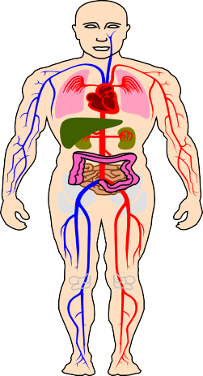
VA Compensation for
Service-Connected Disability
VA rates disabilities 0% - 100%
Each % has an assigned dollar amount
Basic rates effective 1 December 2022 (Veteran only): from
$165.92 (10%) to $3,621.95 (100%), (30% & higher = Extra dependent allowance)
Tax free payments
For Retired Soldiers <50% disabled, disability pay offsets military retired pay dollar for dollar
Free VA medical care for service-connected conditions
0% rating means a condition is service-connected, but is not severe enough to merit disability pay
https://www.benefits.va.gov/compensation/types-compensation.asp
Notes:
Presenter Notes
2023-03-22 21:16:09
--------------------------------------------
This is how the VA disability compensation process works.
​When your combined conditions total more than 10%, you will receive a monthly tax-free compensation from the VA. (Unless you are rated 50% or more - under current law, your VA tax-free compensation amount offsets your Military retired pay $-for-$.)
Each percentage of disability pays a set dollar amount which is increased by COLA each year. It is unrelated to your grade, rank, or Military retired pay amount. (It was de-linked from pay grade in 1993.) A rating from the VA of 30% disabled or higher provides additional monthly amounts to you, based on the number of dependents you have, to include your spouse.

Slide 27
CRSC & CRDP Comparison
Combat-Related Special Compensation | Concurrent Retirement and Disability Pay
Combat-related disabilities | Service-connected disabilities
Armed conflict (e.g., wounds) Simulated combat (e.g., FTX) | Retired pay that would have been waived by the Soldier in order to receive disability pay is restored (i.e., no $ for $ off-set of retired pay)
Hazardous service (e.g., parachute duty)
Instrumentalities of war (e.g., combat vehicles)
10%-100% disability rating (combat-related) | 50%-100% disability rating (service-connected)
Not taxable; not divisible in divorce | Taxable; divisible in divorce
Receiving retired pay | Qualified retiree receiving retired pay*
Must apply to HRC | Automatic; no application required
https://www.hrc.army.mil/TAGD/Apply%20for% 20CRSC | https://www.dfas.mil/retiredmilitary/disability/cr dp.html
*A member or former member of the uniformed services who is entitled for any month to retired pay is a qualified retiree. (Special Rules for Chapter 61 Disability Retirees)
Notes:
Presenter Notes
2023-03-22 21:16:09
--------------------------------------------
CRDP – Qualified Retirees
Any retiree (other than Chapter 61 with less than 20) *see below
Chapter 61 retiree with 20 years of 1405 service is qualified at disability retirement date
Chapter 61 retiree with 20 years of 12732 service is qualified at non-regular retirement eligible age With a qualifying disability (50% or more) from the VA
CRDP – Not Qualified Retirees
Chapter 61 retirees with less than 20 years of service are not qualified retirees for CRDP, years of service computed under section 1405 or 12732

Slide 28
Retired and Disability Payments
Tying It All Together
Retired pay is reduced dollar-for-dollar by VA Disability Pay unless the Soldier qualifies for Concurrent Retired and Disability Pay (CRDP)
$3,000
$2,500
$2,000
$1,500
$1,000
$500
$0
Soldier A Retired Pay Only
(0% VA
Disability)
Soldier B Retired & VA Disability Pay (10-40% VA
Disability)
Soldier C Retired & VA Disability
Pay & CRSC
(10-40% VA
Disability)
Soldier D CRDP
(50-100% VA
Disability)
Retired Pay Disability Pay CRSC
NOTE 1: All Soldiers retired at the same pay grade and years of service
NOTE 2: CRDP based on the length of service retirement. For non-regular service, this starts when Retired Soldier is eligible for non-regular retired pay.
Notes:
Presenter Notes
2023-03-22 21:16:09
--------------------------------------------
The blue = disability pay is tax free The red = CRSC is tax free

Slide 29
TRICARE Coverage - Retired RC Soldiers
Retired Reserve Coverage Timeline
Under age 60 | 60 | 61 | 62 | 63 | 64 | Age 65+
Gray Area Retired Soldiers May qualify to purchase TRICARE Retired Reserve | Eligible for TRICARE Select TRICARE Prime or US Family Health Plan (where available) |  |  |  |  | Begin TRICARE For Life
Note: TRICARE Standard and TRICARE Extra plans transitioned to TRICARE Select. Retired members can choose between TRICARE Select, TRICARE Prime, or Uniformed Services Family Health Plan (USFHP)
For information and assistance: https://tricare.mil/Plans/HealthPlans
Notes:
Presenter Notes
2023-03-22 21:16:09
--------------------------------------------
Upon turning age 60 and collecting retirement pay, Tricare Retired Reserve (TRR) members are dis-enrolled from TRR and may be eligible for other TRICARE programs as retirees, such as: TRICARE Select
TRICARE Prime (if in a PSA), including the US Family Health Plan Tricare For Life (TFL) (Age 65+)
If entitled to premium-free Medicare Part A at age 60 or older, Retired Reserve members must also have Medicare Part B to be TRICARE-eligible. Before age 65, these beneficiaries have the option to use TRICARE Prime or TFL. At age 65, coverage transitions to TFL.

Slide 30

TRICARE Plans
See https://www.tricare.mil for more details
TRICARE Retired Reserve – Available to members in the
Retired Reserve who are qualified for non-regular retirement and are currently under age 60.
  Not subsidized. Premiums are $549.35 per month (Member Only) or
$1320.76 per month (Member and Family), plus copays and cost shares.
TRICARE Prime – Managed care option. MTFs are principal source of health care (100% covered). Available to Retired Guard/Reserve members at age 60 and their families.
  Annual fee is $703.92 per family or $351.96 per individual plus co-pays for treatment at non-MTF TRICARE network providers.
TRICARE Select – Fee for Service Plan. Schedule appointments with any TRICARE authorized provider. Available to Retired Guard/Reserve members at age 60 and their families.
  Annual fee ($345/family, $171.96/individual), plus copays and cost shares based on the type of care and type of provider you see. Deductible of $150 (individual), no more than $300 per family.
NOTE: CY 23 Group A rates reflected
Notes:
Presenter Notes
2023-03-22 21:16:09
--------------------------------------------
You must enroll in either TRICARE Prime or TRICARE Select by the effective date of retirement to be eligible for continuous health care coverage.
The next several slides present a very broad overview of a retiree’s healthcare options using TRICARE, TRICARE-for-Life, TRICARE Retiree Dental Plan, and the TRICARE Pharmacy program. This slide highlights what your options are while on active duty, and what changes when you retire.
The TRICARE program is very complex and warrants an in-depth briefing from an expert.
You can get a higher level of information at the TRICARE website https://www.tricare.mil and from any installation Health Benefits Advisor (HBA). TRICARE beneficiaries fall into one of two groups: Group A or Group B
You’re in Group A if your initial enlistment or appointment or that of your uniformed services sponsor began before Jan. 1, 2018. You’re in Group B if your initial enlistment or appointment or that of your uniformed services sponsor began on or after Jan. 1, 2018.
Note: When enrolled in TRICARE Reserve Select (TRS), TRICARE Retired Reserve (TRR), TRICARE Young Adult (TYA), or the Continued Health Care Benefit Program (CHCBP), Group A beneficiaries follow Group B deductibles and applicable copayments or cost-shares.

Slide 31

Federal Employee Dental and
Vision Insurance Program (FEDVIP)
FEDVIP offers supplemental vision coverage to those enrolled in a TRICARE health plan
There are 12 dental and 5 vision carriers to choose from
  FEDVIP also offers national and international plans, with some plans featuring both high and standard options
Retiring service members can enroll in a FEDVIP dental and/or vision plan between 31 days prior to their military retirement date and up to 60 days following
  To prevent a gap in coverage between your active duty or reserve plan and your new FEDVIP plan, you must enroll prior to your military retirement date
BENEFEDS is the online portal that you can use to research, enroll in, and manage your FEDVIP coverage
Visit https://www.benefeds.com/military for more information
Notes:
Presenter Notes
2023-03-22 21:16:09
--------------------------------------------
Federal Employee Dental and Vision Insurance Program (FEDVIP)
FEDVIP is a voluntary, enrollee-pay-all dental and vision insurance program. It replaces the former TRICARE Retiree Dental Program (TRDP) and offers supplemental vision coverage to those enrolled in a TRICARE health plan. In general, retired uniformed service members, their families, and survivors are eligible for FEDVIP dental coverage and, if enrolled in a TRICARE health plan, FEDVIP vision coverage.
In addition, family members of active duty uniformed service members who are enrolled in a TRICARE health plan are eligible for FEDVIP vision coverage. (Active duty uniformed service members are not eligible for FEDVIP dental and vision coverage.)
With 12 dental and 5 vision carriers to choose from, FEDVIP offers choice and flexibility for you and your family:
National and international plans, with some plans featuring both high and standard options A choice between three enrollment types: self, self plus one, or self and family
FEDVIP is sponsored by the U.S. Office of Personnel Management (OPM) and is popular among federal employees; the more than 5 million people already enrolled give the program high marks for quality and value. So when can you enroll?
If you are retiring from the uniformed services, you have a 91-day enrollment window to enroll in a FEDVIP dental and/or vision plan. You are eligible to enroll between 31 days prior to your military retirement date and 60 days following.
To prevent a gap in coverage between your active duty or reserve plan and your new FEDVIP plan, you must enroll prior to your military retirement date.
Please note, enrollment is not automatic. If you don’t enroll within 60 days following your retirement date, you will need to wait until the next Federal Benefits Open Season to do so.
FEDVIP is a payroll/annuity deduction program.
You are encouraged to visit BENEFEDS, the secure online portal to enroll in FEDVIP to research FEDVIP’s current list of carriers and plans and use the site’s plan comparison tool to view rates, benefits, and coverage information. BENEFEDS.com/military is the page dedicated to military families, including those transitioning into retirement.

Slide 32

SGLI & VGLI
If you wish to convert your SGLI to VGLI, you must do so within one year and 120 days of: retiring or being released from the Ready Reserve or National Guard; of assignment to the Individual Ready Reserve (IRR) of a branch of service; of assignment to the Inactive National Guard (ING); or if you suffered an injury or disability (damage to your body or mind that makes it hard for you to do everyday tasks, including meaningful work) while on duty—including direct traveling to and from duty—that disqualified you for standard premium insurance rates.
If you submit a VGLI application within 240 days, you can obtain coverage regardless of health.
You can retain VGLI for as long as you pay the premiums. Premiums may be paid by allotment, check, or money order, if paid monthly
Discounts are offered for the following pay schedules:
  quarterly (2.5%)
  semi-annually (3.75%)
  annually (5%)
All terminally ill policyholders with less than 9 months to live will be eligible to take up to 50% of their SGLI or VGLI coverage in a lump sum.
Applying for VGLI is simple using one of the following methods:
Apply through the Office of Servicemembers’ Group Life Insurance (OSGLI), https://giosgli.prudential.com/osgli/OnlineFillableAppController/NBEnrollment
Apply through https://www.ebenefits.va.gov/
Download and complete SGLV 8714, Application for Veterans' Group Life Insurance and mail it to OSGLI
https://www.benefits.va.gov/insurance/index.asp
Notes:
Presenter Notes
2023-03-22 21:16:10
--------------------------------------------
You must apply to convert SGLI to VGLI within one year and 120 days of: retiring or being released from the Ready Reserve or National Guard;
If you submit a VGLI application within 240 days, you can obtain coverage regardless of health. You can retain VGLI for as long as you pay the premiums.

Slide 33
Veterans Affairs Life Insurance (VALife)
Veterans Affairs Life Insurance (VALife) provides low-cost coverage to Veterans with service-connected disabilities. VALife is guaranteed acceptance whole life insurance.
If you are age 80 or younger:
  You’re eligible for VALife if you have a VA service-connected disability rating, even if your rating is 0%.
  There’s no time limit to apply after getting your disability rating.
If you are age 81 or older, you may be eligible for VALife if you meet these requirements:
  You applied for VA disability compensation before you turned 81 years old,
and
  You got your service-connected disability rating after you turned 81, and
  You apply for VALife within 2 years of getting notification of your disability rating
You can get these benefits:
  Up to $40,000 in whole life insurance coverage (in $10,000 increments), and
  Cash value that starts to add up 2 years after the VA approves your application
https://www.benefits.va.gov/insurance/VALife.asp

Slide 34

VA Information Sources
Online
http://www.va.gov
https://www.ebenefits.va.gov/ebenefits-portal/ebenefits.portal
Send e-mail inquiries
Download forms
Get benefits information
Apply for benefits
By Phone
Health Care:
Benefits:
Education:
VA Life Insurance:
SGLI/VGLI:
1-877-222-VETS (8387)
1-800-827-1000
1-888-442-4551 (GIBILL-1)
1-800-669-8477
1-800-419-1473
In-Person
County VA Director (blue pages of phone book)
Notes:
Presenter Notes
2023-03-22 21:16:10
--------------------------------------------
There are many ways to access detailed VA information. Here are the best sources.

Slide 35
At Retirement, You Will Receive…
DD Form 363, Retirement Certificate
DD FORM 2542, Presidential Certificate of Appreciation for Service in the Armed Forces of the United States – Presented to Soldiers retiring with 20 or more years of active service (15 when early retirement authorized), medical retirements, upon transfer to the Retired Reserve (reserve components), TDRL or PDRL
Presidential Letter of Appreciation - Presented to service members retiring with 30 or more years of service or special category (e.g., CSA, SMA, Medal of Honor Recipient or former POWs who qualify for or have been awarded the POW Medal.)
Chief Army Reserve Retirement Certificate (USAR)
Retirement Ceremony (optional)
DA Form 3891, Army Spouse Certificate of Appreciation (if applicable)
Army Retiring Soldier Commendation Program (ARSCP) Package (see next slide)
Notes:
Presenter Notes
2023-03-22 21:16:10
--------------------------------------------
- You will receive a CERTIFICATE of Presidential Recognition if you have completed at least 20 years of active service (or qualifying service if a RC member).
- You will receive a LETTER of Presidential Recognition if you have completed at least 30 years of service or are in one of the following special categories: Chairman or Vice Chairman, JCS; CSA; SMA; Recipient of the Medal of Honor; Former POW who qualifies for or has been awarded the POW Medal. U.S. flags are issued to all Soldiers who retire from active duty on or after 1 Oct 98 and from a reserve component on or after 1 Oct 99. Reserve Component Soldiers are eligible to receive a U.S. flag when they have completed 20 qualifying years for reserve retirement purposes.
- You will be given the opportunity to participate in a retirement ceremony.
- You will also receive a retirement certificate, spouse appreciation certificate (if applicable), Army Retiring Soldier Commendation Program Package - (U.S. Flag, Army Retired Pin, Retired Decals, and Tri-Signed Letter). These items are usually provided by your Transition Center, but sometimes units prefer to provide them during a unit ceremony.

Slide 36



Army Retiring Soldier Commendation Program
The Army Retiring Soldier Commendation Program package (ARSCP), was created by ASA (M&RA) in 2009
Flag required by T10 USC §12605 since 1999 for reserve component service retirements
U.S. Army Retired Lapel Button required by Army policy since 1968 IAW AR 600-8-22
Presented to Reserve Component Soldiers upon transfer to the Retired Reserve or discharge after reaching retirement eligibility
Package contains a letter signed by the Secretary of the Army, the Army Chief of Staff, and the Sergeant Major of the Army, a U.S. Flag, a U.S. Army Retired Lapel Button, and two Soldier for Life window decals.
State, and RD/MSC Retirement Services Officers order ARSCP packages
Notes:
Presenter Notes
2023-03-22 21:16:10
--------------------------------------------
U.S. flags are issued to all Soldiers who retire from active duty on or after 1 Oct 98 (T10 USC section 7251), or from a reserve component on or after 1 Oct 99 (T10 USC Section 12605). Reserve Component Soldiers are eligible to receive a U.S. flag when they have completed the years of service required for eligibility for retired pay under T10 USC chapter 1223.

Slide 37
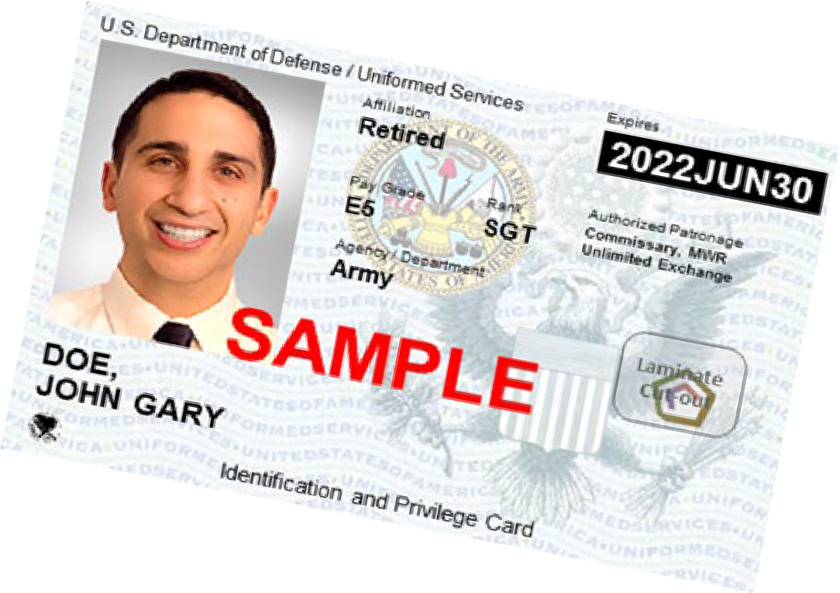
Impact of ID Card Changes at Retirement
Soldier turns in Common Access Card (CAC)
The Retired Uniformed Services ID (USID) card is not a CAC, so…
  No access to DoD Enterprise Email
  No access to CAC-enabled systems
  Must change myPay account to commercial email
  Must obtain DS Logon Account to access records and systems
DoD has transitioned to the issuance of a more secure next generation USID to replace the former paper-based USID. Although the new USID looks like a CAC, it does not contain a chip. For more information go to https://www.cac.mil/Next- Generation-Uniformed-Services-ID-Card/
DS Logon: Request an account online at https://www.dmdc.osd.mil/identitymanagement or visit an ID Card facility or VA Regional Office
Notes:
Presenter Notes
2023-03-22 21:16:10
--------------------------------------------
You should set up your DS Logon Account when you are in 12-mth window
If done using your CAC, you CAC will pull your certificates to create your secure DS logon. Without the CAC you will have to manually enter the information which can be a lengthy process and leaves room for error. Without a DS Logon you will not have access to CAC enabled systems websites like myPay.

Slide 38

Websites Accepting DS Logon
Army Review Board Agency (ARBA) Case Tracking System (ACTS)
Army Transition Assistance Program (TAP) Portal
Consolidated ID Card Office Online
U.S. Army Human Resources Command (HRC) - interactive Personnel Electronic Records Management System (iPERMS) and My Record Portal
milConnect
Military Health System GENESIS Patient Portal (MHS GENESIS Patient Portal)
My Military Health System GENESIS (MY MHS GENESIS)
TRICARE Online (TOL) (website and mobile app)
U.S. Department of Veterans Affairs (VA) - VA.gov/
Integrated Personnel and Pay System - Army (IPPS-A)
https://www.dmdc.osd.mil/identitymanagement

Slide 39




MyArmyBenefits
Benefit Library
Federal Fact Sheets
State and Territory Benefits Fact Sheets
Resource Locators
Benefit Calculators
Benefit Library
Retirement
Survivor Benefits
Deployment Calculator
Casualty Operations Special Module
Survivor Benefits Report
Benefits Help Desk Operations
Help Desk
https://myarmybenefits.us.army.mil
Benefit Calculators link directly to DEERS information through CAC or DS Logon.
39

Slide 40
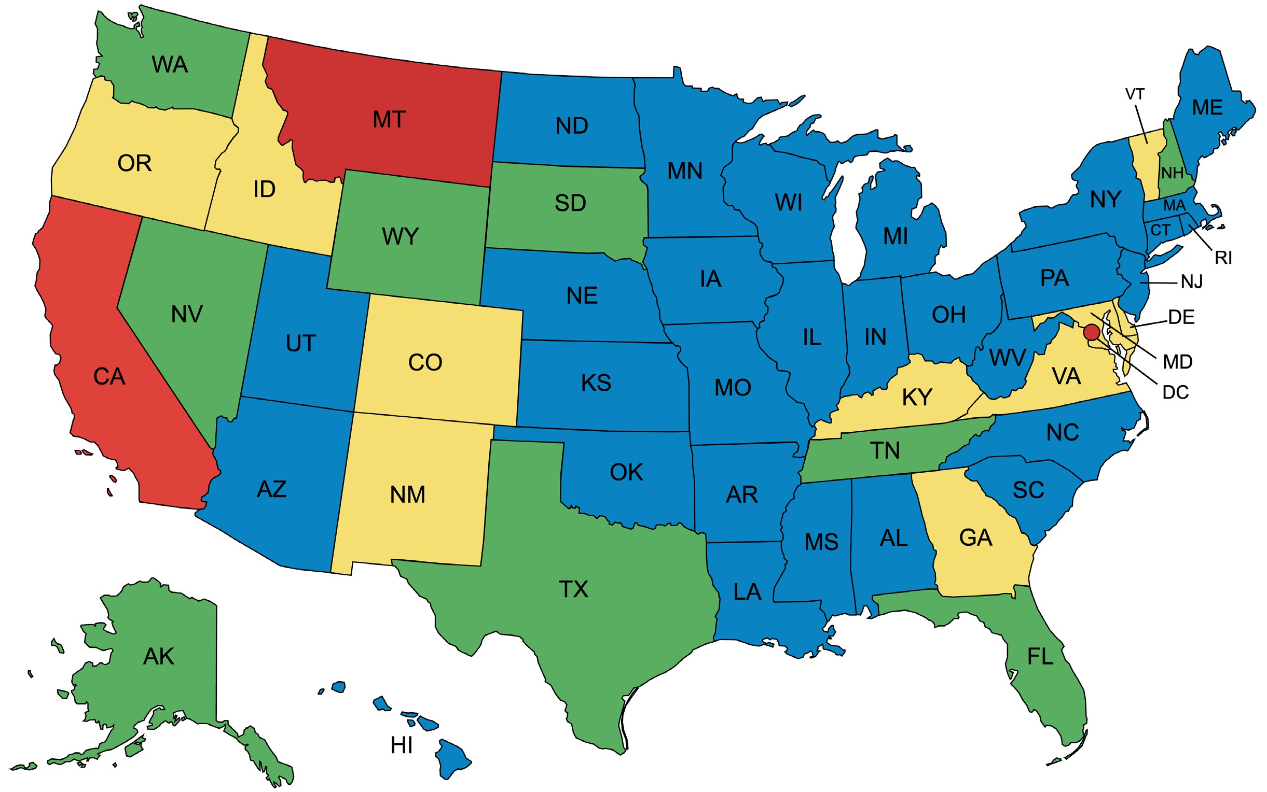

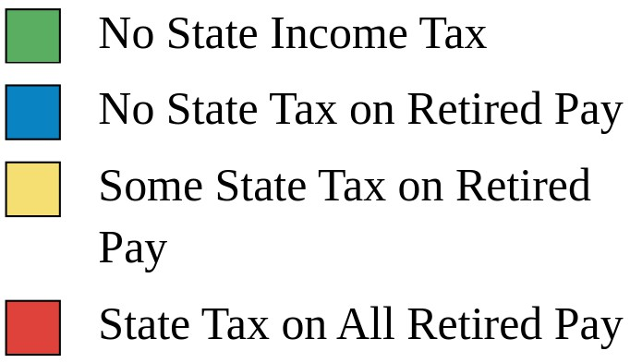


Taxes*
Federal taxes are due on all retired military compensation
Home of Residence is determining factor; not Home of Record!
You pay NO Social Security or Medicare tax on retired pay. You’ll collect full Social Security benefits when you reach the age of eligibility!
*State taxes as of 15 March 2023. Conditions or limitations apply. Check state law. See the MyArmyBenefits state fact sheets at https://myarmybenefits.us.army.mil/Benefit-Library/State/Territory-Benefits for details.

Slide 41


Army Echoes
The Army’s official newsletter for Retired Soldiers
Delivered electronically to your email address in myPay
Change your email address in myPay to a commercial email address before you retire!
iPhone & Android phone apps
Read the Army Echoes Blog to receive frequent news between editions at https://soldierforlife.army.mil/retirement/blog

Slide 42

Retired Soldier Motto:
“Your mission has changed, but your duty has not”
Opportunities to Still Serve include:
JROTC Instructor
Installation volunteer positions
Military service organizations
Veterans service organizations
Talk to your retirement services officer about joining
Installation Retiree Councils
CSA Retired Soldier Council
Recent Council reports available at:
https://soldierforlife.army.mil/retirement/csa-retired-soldier-council
Notes:
Presenter Notes
2023-03-22 21:16:12
--------------------------------------------
Many Retired Soldiers continue to LIVE the Army retiree motto --“Once a Soldier, always a Soldier…a Soldier for Life” If interested in learning of ways to continue serving, contact your nearest installation Retirement Services Officer (RSO). Perhaps service on their installation Retiree Council appeals to you.
We’d like you to consider it now in light of what you might like to do after retirement.
One of the duties of an installation Retiree Council is to formulate issues annually to “send up” to the Chief of Staff, Army Retired Soldier Council for their deliberation and possible briefing to the Chief. The 14-member CSA Retired Soldier Council serves Retired Soldiers worldwide and is comprised of seven officers and seven enlisted members. They serve at the approval of the CSA for 4-year terms.

Slide 43
Where Do You Find Retirement Information?
Army G-1 Retirement Services Office Homepage https://soldierforlife.army.mil/Retirement
  DA Retirement Planning Guide
  USAR & ARNG Non-Regular Retirement Guides
  DA Survivor Benefit Plan (SBP) Briefing
MyArmyBenefits at https://myarmybenefits.us.army.mil/
Army Installation Retirement Services Officers (RSOs) https://soldierforlife.army.mil/Retirement/contact-us
HRC Gray Area Retirements Branch https://www.hrc.army.mil/content/Gray%20Area%20Retirements%20Branch
USAR Readiness Division RSOs listed at https://soldierforlife.army.mil/Retirement/ArmyReserve
State RSOs can assist National Guard Soldiers https://myarmybenefits.us.army.mil/Benefit-Library/Resource-Locator
SBP vs. Life Insurance Comparison tool https://actuary.defense.gov/Survivor-Benefit-Plans/
Notes:
Presenter Notes
2023-03-22 21:16:12
--------------------------------------------
This is an overview of different websites you can access with retirement information.

Slide 44










https://soldierforlife.army.mil/Retirement
https://www.dvidshub.net/unit/HQDA-RSO
@USArmySoldierForLife
@USArmySoldierForLife
@USArmySFL
@USArmySFL
@USArmySFL
@USArmySFL
https://soldierforlife.army.mil/Retirement/change-of-mission
https://soldierforlife.army.mil/Retirement/army-echoes https://soldierforlife.army.mil/Retirement/blog
Join the conversation
44

Slide 45


Thank you for your service!!
QUESTIONS?
45

